Slide 1
Logistic regression lab4
Eng: Samar Shaban

Slide 2
Problem: Recognizing cat pictures.
Algorithm: Logistic Regression with neural network mindset
Performance matrix: Accuracy

Slide 3
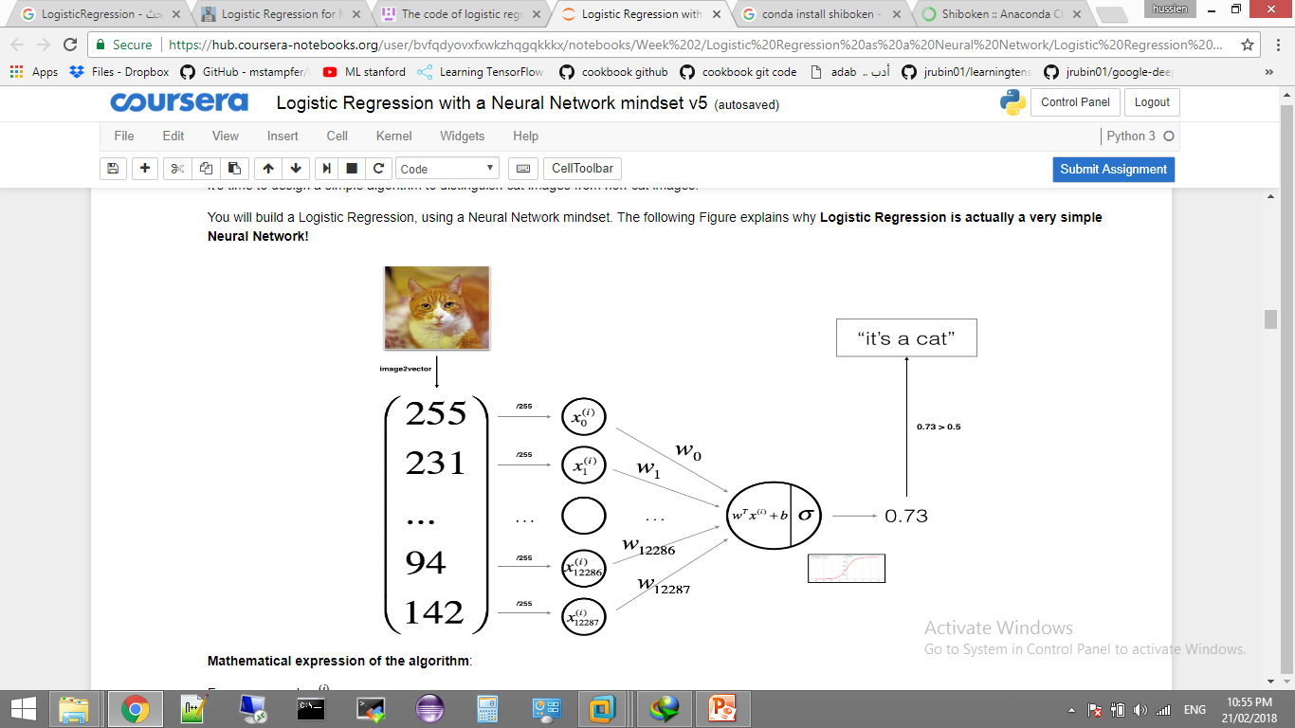

Slide 4
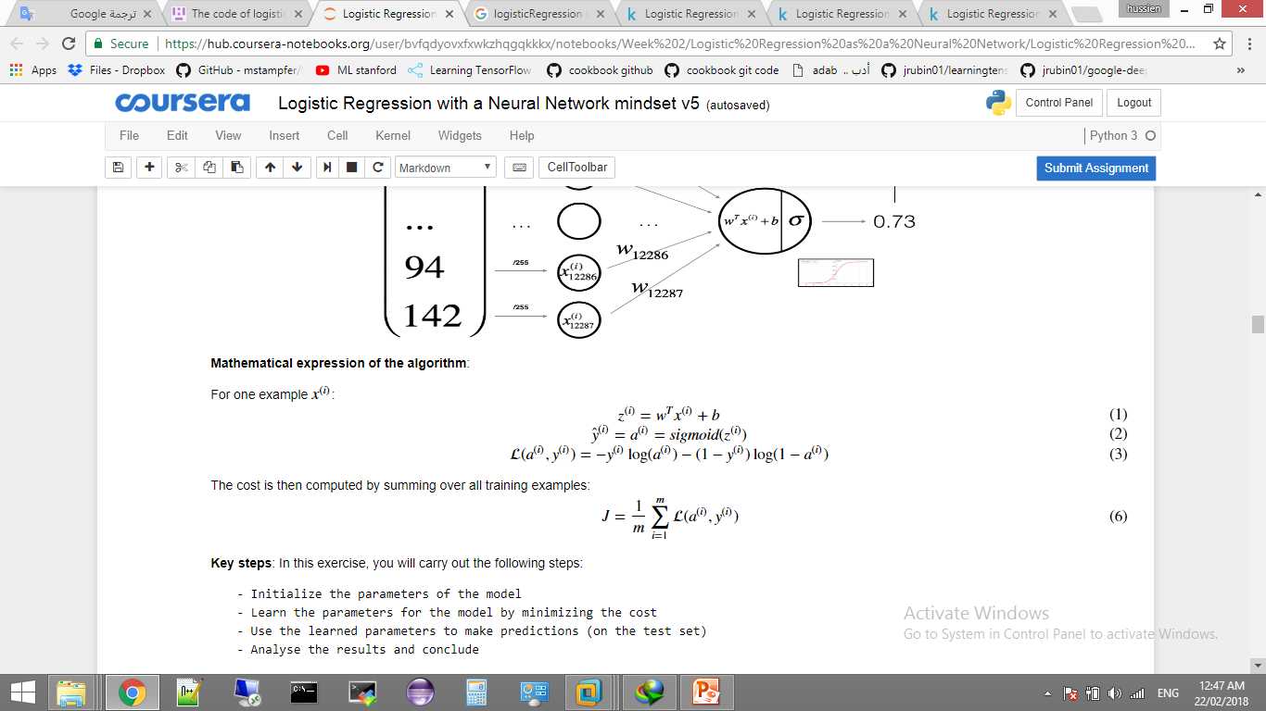

Slide 5
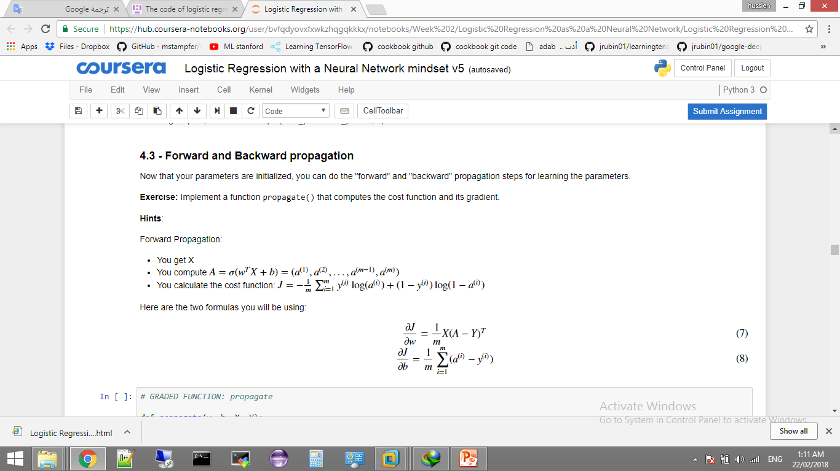

Slide 6
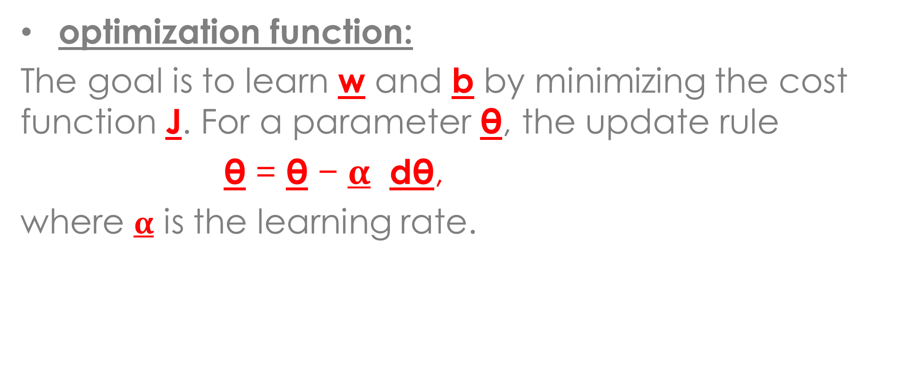
optimization function:
The goal is to learn w and b by minimizing the cost function J. For a parameter θ, the update rule
θ = θ − $α$ dθ,
where $α$ is the learning rate.

Slide 7
function | parameters | Returned values
load_dataset() |  | train_set_x_orig, train_set_y_orig, test_set_x_orig, test_set_y_orig, classes
initialize() | dim | w, b
Propagate() | w, b, X, Y | grads = {"dw": dw, "db": db} cost
optimize() | w, b, X, Y, num_iterations, learning_rate, print_cost = False | params = {"w": w, "b": b} grads = {"dw": dw, "db": db} costs
Predict() | w, b, X | Y_prediction
model() | X_train, Y_train, X_test, Y_test, num_iterations = 2000, learning_rate = 0.5, print_cost = False | d = {"costs": costs, "Y_prediction_test": Y_prediction_test, "Y_prediction_train" : Y_prediction_train, "w" : w, "b" : b, "learning_rate" : learning_rate, "num_iterations": num_iterations}

Slide 8
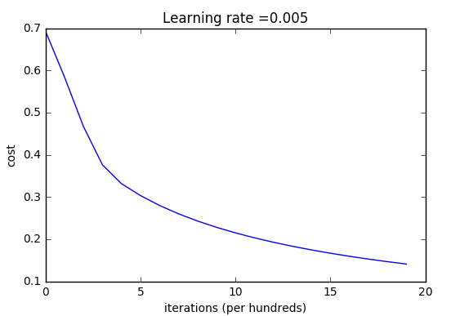
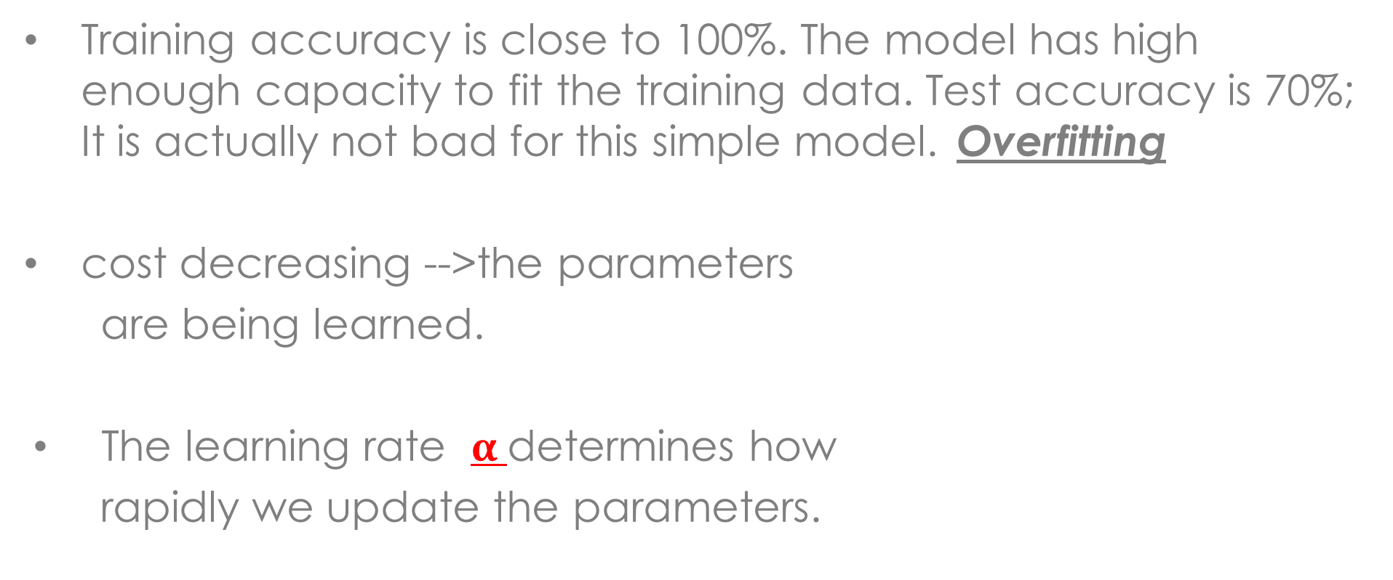
Notes :
Training accuracy is close to 100%. The model has high enough capacity to fit the training data. Test accuracy is 70%; It is actually not bad for this simple model. Overfitting
cost decreasing -->the parameters
are being learned.
The learning rate $α$determines how
rapidly we update the parameters.

Slide 9
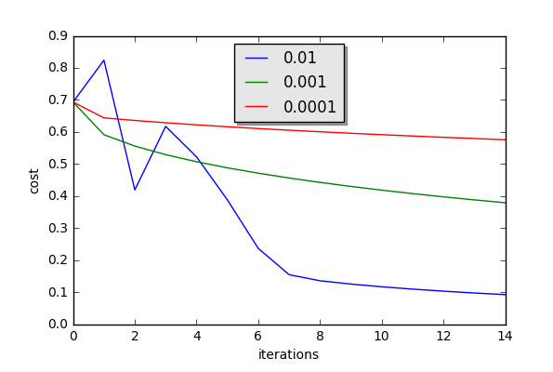
Different learning rates give different costs and thus different
predictions results.

Slide 10
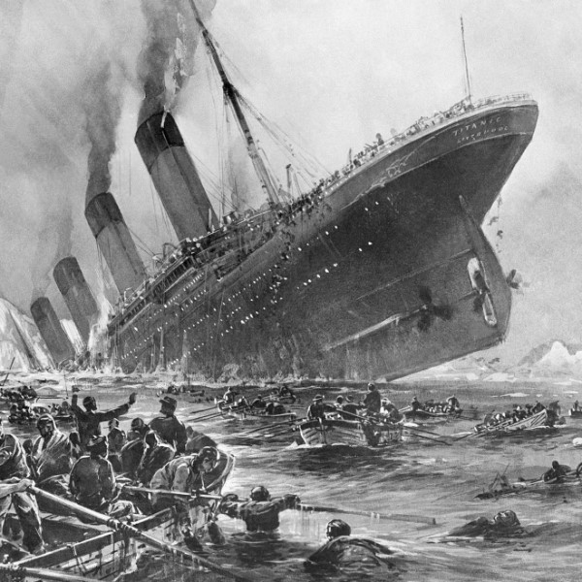
Implement :
Apply logistic regression
as explained on
Titanic Passengers Dataset.
Score: 8 of 10
Give me some analytical indicators
About the Dataset.
Score 2

